Slide 1
408216 Data Mining and Knowledge Engineering
Unsupervised Data Mining Algorithms

Slide 2
Learning Outcomes
Examine the Apriori algorithm used for learning association rules
Discuss two different algorithms for data clustering

Slide 3
Mining Association Rules
Naïve method for finding association rules:
    Using the standard separate-and-conquer method, treating every possible combination of attribute values as a separate class
Two problems:
    Computational complexity
    Resulting number of rules (which would have to be pruned on the basis of support and confidence)
But: we can look for high support rules directly!

Slide 4

Association Rule Mining
Given a set of transactions, find rules that will predict the occurrence of an item based on the occurrences of other items in the transaction
Market-Basket transactions
Example of Association Rules
{Diaper} → {Beer},
{Milk, Bread} → {Eggs,Coke},
{Beer, Bread} → {Milk},
Implication means co-occurrence, not causality!

Slide 5

Definition: Frequent Itemset
Itemset
  A collection of one or more items
    Example: {Milk, Bread, Diaper}
  k-itemset
    An itemset that contains k items
Support count (σ)
  Frequency of occurrence of an itemset
  E.g. σ({Milk, Bread,Diaper}) = 2
Support
  Fraction of transactions that contain an itemset
  E.g. s({Milk, Bread, Diaper}) = 2/5
Frequent Itemset
  An itemset whose support is greater than or equal to a minsup threshold

Slide 6



Definition: Association Rule
Association Rule
  An implication expression of the form X → Y, where X and Y are itemsets
  Example:
  {Milk, Diaper} → {Beer}
Rule Evaluation Metrics
  Support (s)
    Fraction of transactions that contain both X and Y
  Confidence (c)
    Measures how often items in Y
    appear in transactions that
    contain X
Example:

Slide 7
Association Rule Mining Task
Given a set of transactions T, the goal of association rule mining is to find all rules having
  support ≥ minsup threshold
  confidence ≥ minconf threshold
Brute-force approach:
  List all possible association rules
  Compute the support and confidence for each rule
  Prune rules that fail the minsup and minconf thresholds
  ⇒ Computationally prohibitive!

Slide 8
Mining Association Rules
Example of Rules:
{Milk,Diaper} → {Beer} (s=0.4, c=0.67)
{Milk,Beer} → {Diaper} (s=0.4, c=1.0)
{Diaper,Beer} → {Milk} (s=0.4, c=0.67)
{Beer} → {Milk,Diaper} (s=0.4, c=0.67)
{Diaper} → {Milk,Beer} (s=0.4, c=0.5)
{Milk} → {Diaper,Beer} (s=0.4, c=0.5)
Observations:
All the above rules are binary partitions of the same itemset:
{Milk, Diaper, Beer}
Rules originating from the same itemset have identical support but
can have different confidence
Thus, we may decouple the support and confidence requirements

Slide 9
Mining Association Rules
Two-step approach:
  Frequent Itemset Generation
    Generate all itemsets whose support ≥ minsup
  Rule Generation
    Generate high confidence rules from each frequent itemset, where each rule is a binary partitioning of a frequent itemset
Frequent itemset generation is still computationally expensive

Slide 10

Frequent Itemset Generation
Given d items, there are 2^{d} possible candidate itemsets

Slide 11

Frequent Itemset Generation
Brute-force approach:
  Each itemset in the lattice is a candidate frequent itemset
  Count the support of each candidate by scanning
  the database
  Match each transaction against every candidate
  Complexity ~ O(NMw) => Expensive since M = 2^{d} !!!

Slide 12
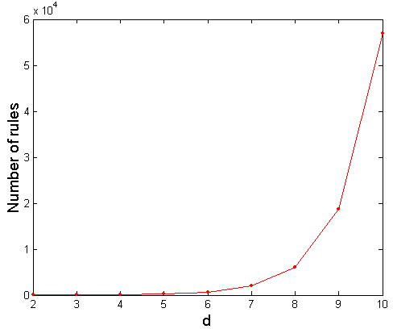
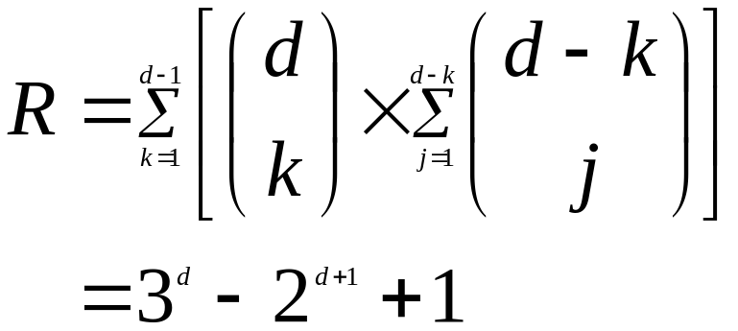
Computational Complexity
Given d unique items:
  Total number of itemsets = 2^{d}
  Total number of possible association rules:
If d=6, R = 602 rules

Slide 13


Illustrating Apriori Principle
Found to be Infrequent
Pruned supersets

Slide 14

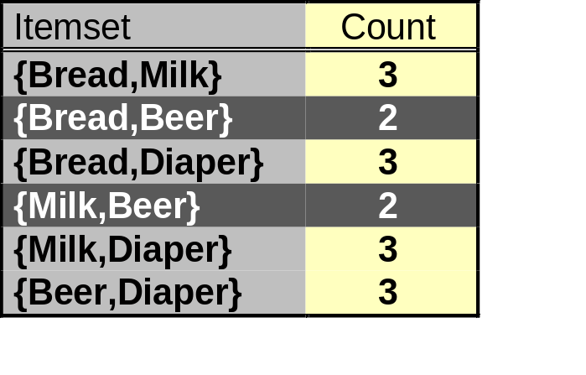
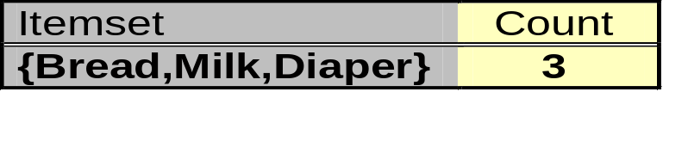
Illustrating Apriori Principle
Items (1-itemsets)
Pairs (2-itemsets)
(No need to generate
candidates involving Coke
or Eggs)
Minimum Support = 3
Triplets (3-itemsets)
If every subset is considered,
⁶C₁ + ⁶C₂ + ⁶C₃ = 41
With support-based pruning,
6 + 6 + 1 = 13

Slide 15
Apriori Algorithm
Method:
  Let k=1
  Generate frequent itemsets of length 1
  Repeat until no new frequent itemsets are identified
    Generate length (k+1) candidate itemsets from length k frequent itemsets
    Prune candidate itemsets containing subsets of length k that are infrequent
    Count the support of each candidate by scanning the DB
    Eliminate candidates that are infrequent, leaving only those that are frequent

Slide 16
Practical Issues with Association Rule Mining
With a large number of item sets the number of rules generated can be very large
Thus best to start with a relatively high support and then decrease the support value in a step-wise fashion
Confidence should always be set at a high value (for example 75% and above)

Slide 17
Practical Applications of Association Rules Mining
Market Basket analysis – discover items that are purchased frequently together
  Knowledge obtained can be used to re-organize shelves
Web Usage Mining – predicting a user’s future web page visits based on pages that the user has accessed previously
Bioinformatics
  finding genes that are highly associated with a particular type of disease
  Understanding the biological functions of genes that have not been fully characterized as yet

Slide 18
Clustering Approaches
Bottom up: at each step join the two closest clusters (starting with single-instance clusters)
  Design decision: distance between clusters
    E.g. two closest instances in clusters vs. distance between means
Top down: find two clusters and then proceed recursively for the two subsets
  Can be very fast
Both methods produce a dendrogram (tree structure)

Slide 19
Clustering Approaches
Bottom up: at each step join the two closest clusters (starting with single-instance clusters)
  Design decision: distance between clusters
    E.g. two closest instances in clusters vs. distance between means
Top down: find two clusters and then proceed recursively for the two subsets
  Can be very fast
Both methods produce a dendrogram (tree structure)

Slide 20
Types of Clusterings
A clustering is a set of clusters
Important distinction between hierarchical and partitional sets of clusters
Partitional Clustering
  A division data objects into non-overlapping subsets (clusters) such that each data object is in exactly one subset
Hierarchical clustering
  A set of nested clusters organized as a hierarchical tree

Slide 21

Partitional Clustering
Original Points
A Partitional Clustering

Slide 22
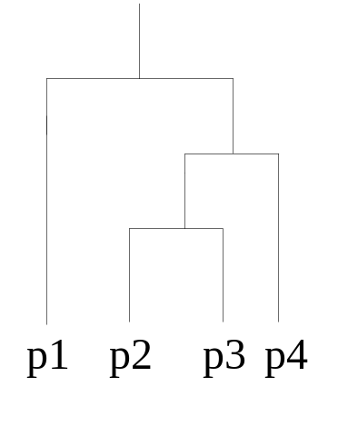
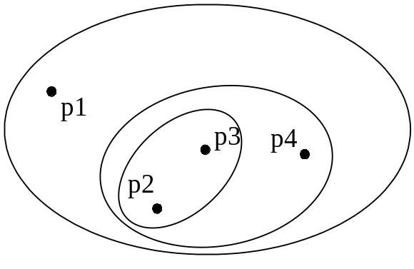
Hierarchical Clustering
Traditional Hierarchical Clustering
Traditional Dendrogram

Slide 23
Clustering Algorithms
K-means and its variants
Hierarchical clustering

Slide 24
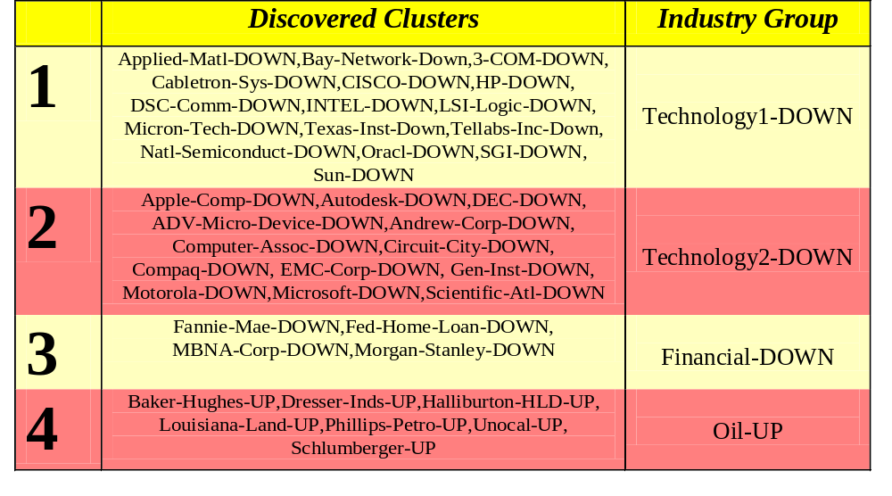
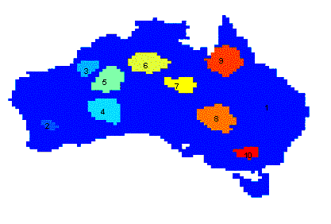
Applications of Cluster Analysis
Understanding
  Group related documents for browsing, group genes and proteins that have similar functionality, or group stocks with similar price fluctuations
Summarization
  Reduce the size of large data sets
Clustering precipitation in Australia

Slide 25
Applications of Cluster Analysis (contd)
Marketing: finding groups of customers with similar behaviour given a large database of customer data containing their properties and past buying records;
Biology: classification of plants and animals given their features;
Libraries: book ordering;
Insurance: identifying groups of motor insurance policy holders with a high average claim cost; identifying frauds;

Slide 26
Applications of Cluster Analysis (contd)
City-planning: identifying groups of houses according to their house type, value and geographical location;
Earthquake studies: clustering observed earthquake epicenters to identify dangerous zones;
WWW: document classification; clustering weblog data to discover groups of similar access patterns.

Slide 27

K-means Clustering
Partitional clustering approach
Each cluster is associated with a centroid (center point)
Each point is assigned to the cluster with the closest centroid
Number of clusters, K, must be specified
The basic algorithm is very simple

Slide 28
K-means Clustering – Details
Initial centroids are often chosen randomly.
  Clusters produced vary from one run to another.
The centroid is (typically) the mean of the points in the cluster.
‘Closeness’ is measured by Euclidean distance
Most of the convergence happens in the first few iterations.
  Often the stopping condition is changed to ‘Until relatively few points change clusters’
Complexity is O( n * K * I * d )
  n = number of points, K = number of clusters,
  I = number of iterations, d = number of attributes

Slide 29



Two different K-means Clusterings
Original Points
Optimal Clustering
Sub-optimal Clustering

Slide 30






Importance of Choosing Initial Centroids

Slide 31
Importance of Choosing Initial Centroids

Slide 32
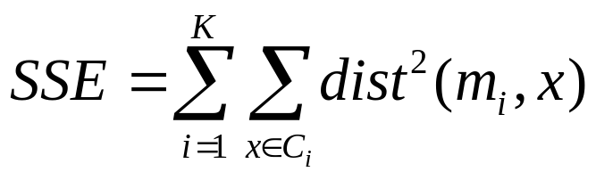
Evaluating K-means Clusters
Most common measure is Sum of Squared Error (SSE)
  For each point, the error is the distance to the nearest cluster
  To get SSE, we square these errors and sum them.
  x is a data point in cluster C_{i} and m_{i} is the representative point for cluster C_{i}
    can show that m_{i} corresponds to the center (mean) of the cluster
  Given two cluster configurations, we choose the one with the smallest error
  One easy way to reduce SSE is to increase K, the number of clusters
    A good clustering with smaller K can have a lower SSE than a poor clustering with higher K

Slide 33
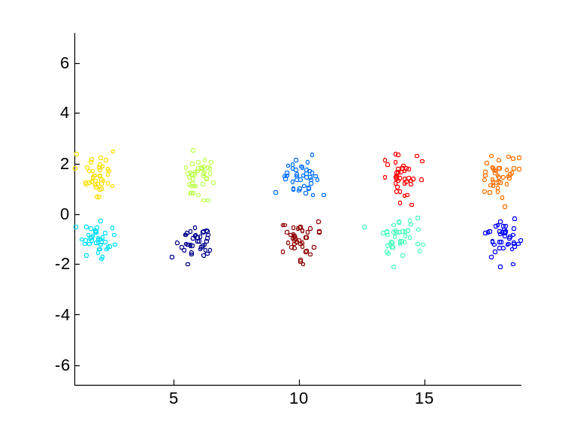
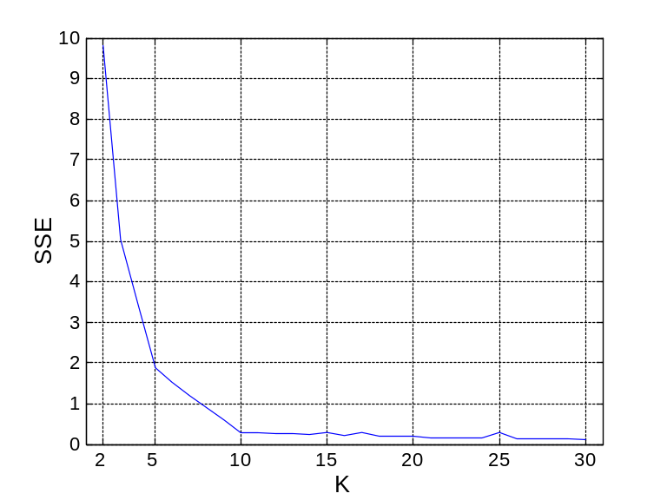
Internal Measures: SSE
Clusters in more complicated figures aren’t well separated
Internal Index: Used to measure the goodness of a clustering structure without reference to external information
  SSE
SSE is good for comparing two clusterings or two clusters (average SSE).
Can also be used to estimate the number of clusters

Slide 34
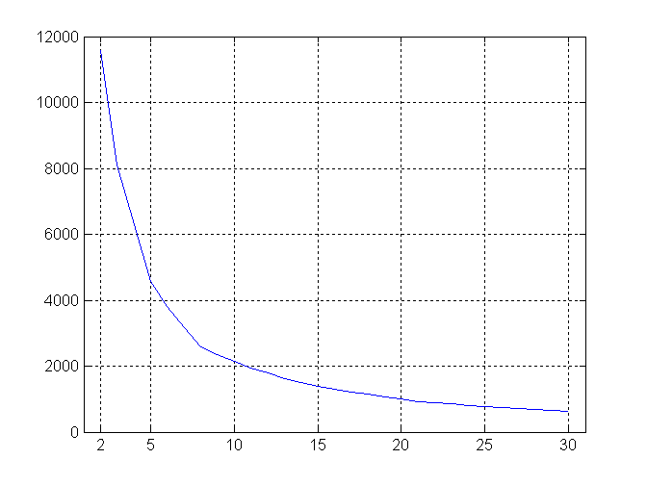
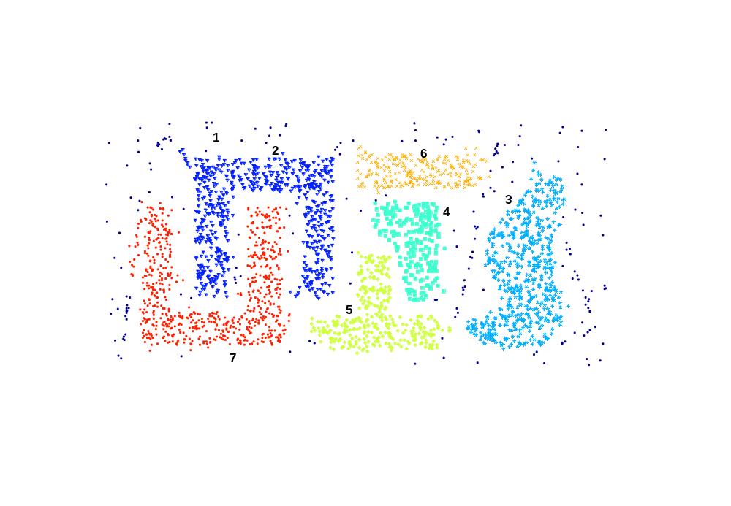
Internal Measures: SSE
SSE curve for a more complicated data set
SSE of clusters found using K-means

Slide 35
Visualizing Clusters in Weka
We use the Iris dataset and cluster using k means with 3 values of k: 3,4,5
First run k means with k=3. We instruct k means to ignore the class attribute and start the clustering process
The cluster visualization option can then be chosen by right clicking on the result pane
In the visualization window the quality can be observed by obtaining a cluster vs instance number plot.

Slide 36
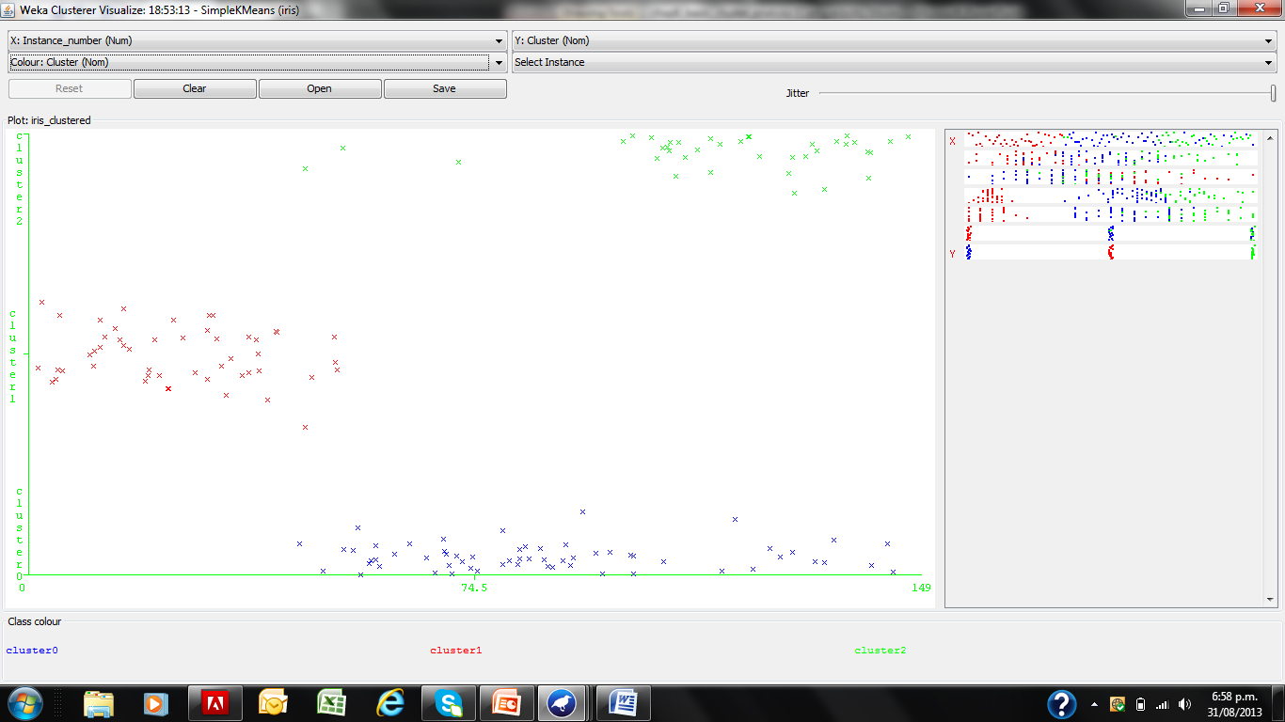
Visualizing k means with k=3

Slide 37
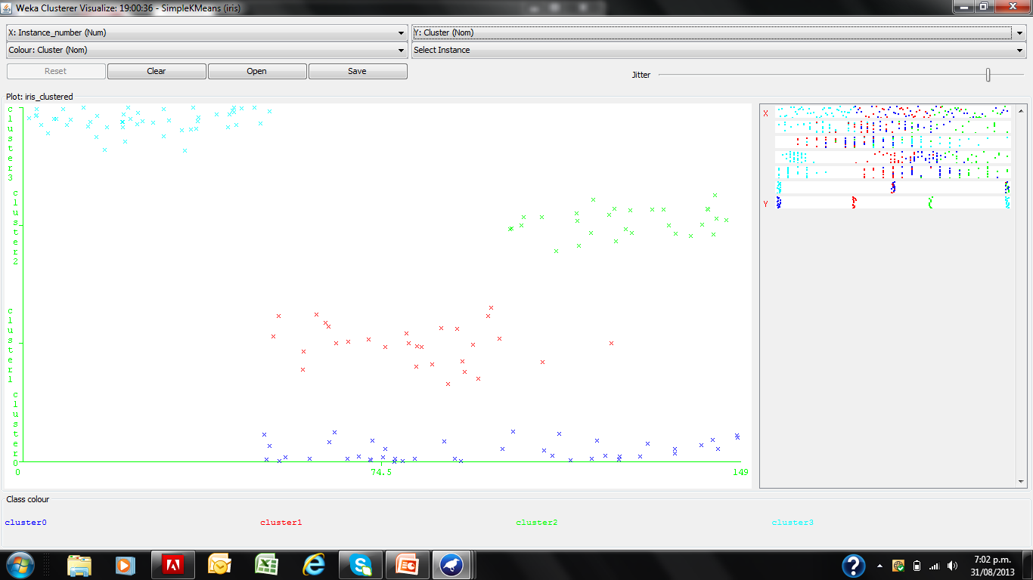
Visualizing k means with k=4

Slide 38
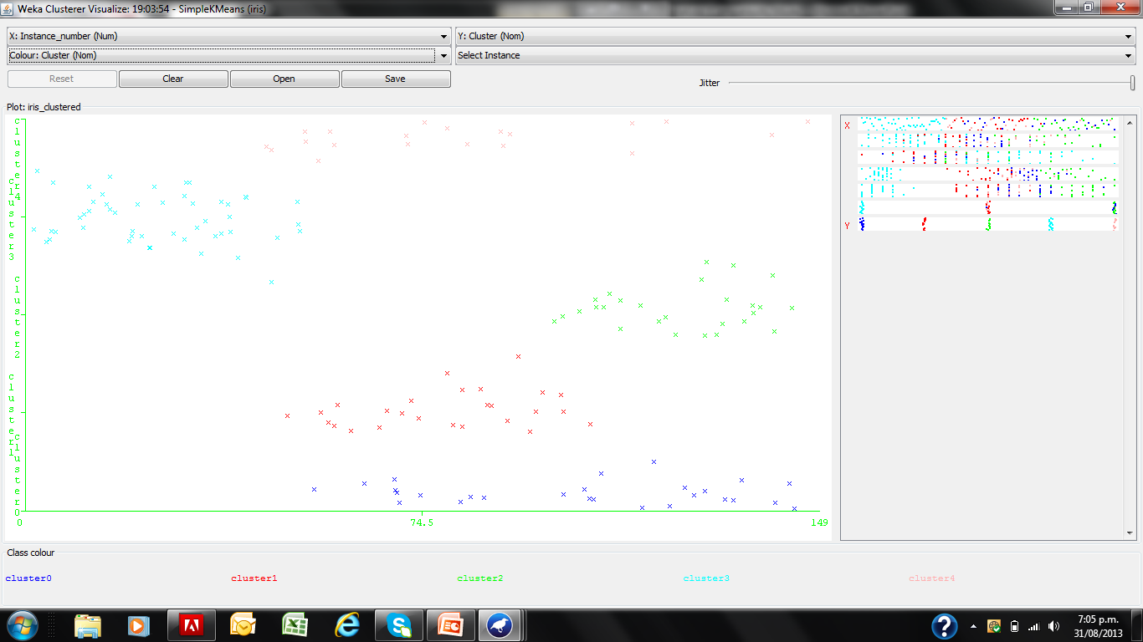
Visualizing k means with k=5

Slide 39
Cluster to Class Evaluation (k=3)
When class labels are available a cluster to class evaluation can be done
Weka supports this as ‘cluster mode option” in the opening screen for k-means
Ensure that the class labels are ignored in the clustering process – the labels are only used for evaluation, and does not play a role in the clustering process

Slide 40
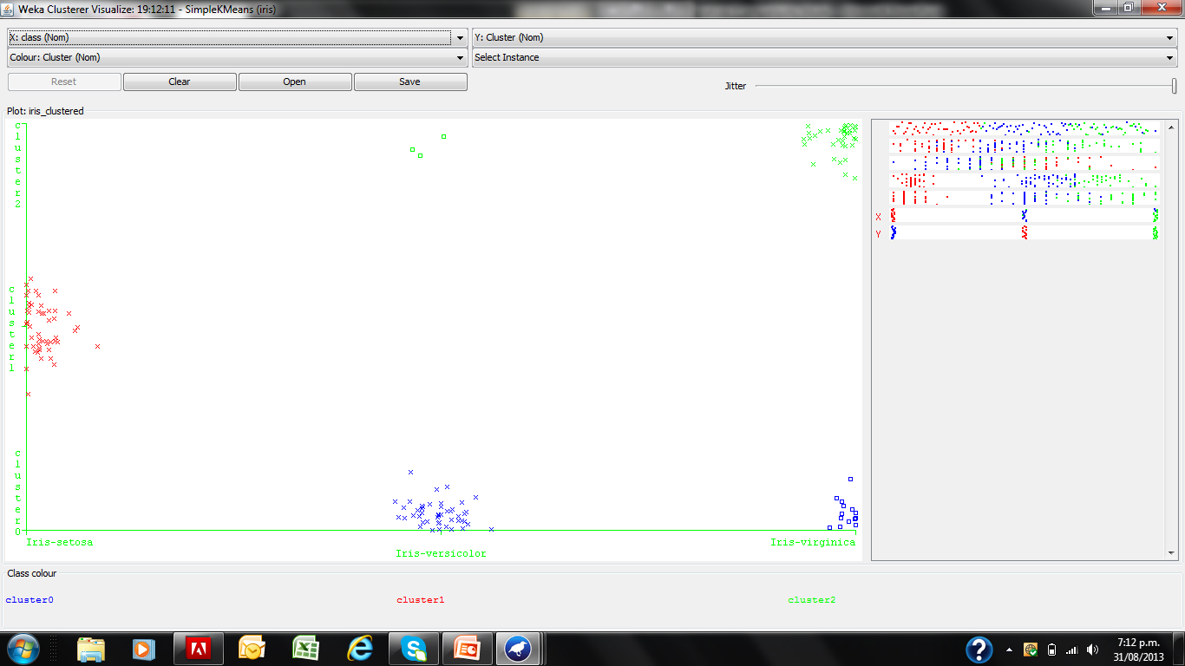
Cluster to Class Evaluation (k=3)

Slide 41
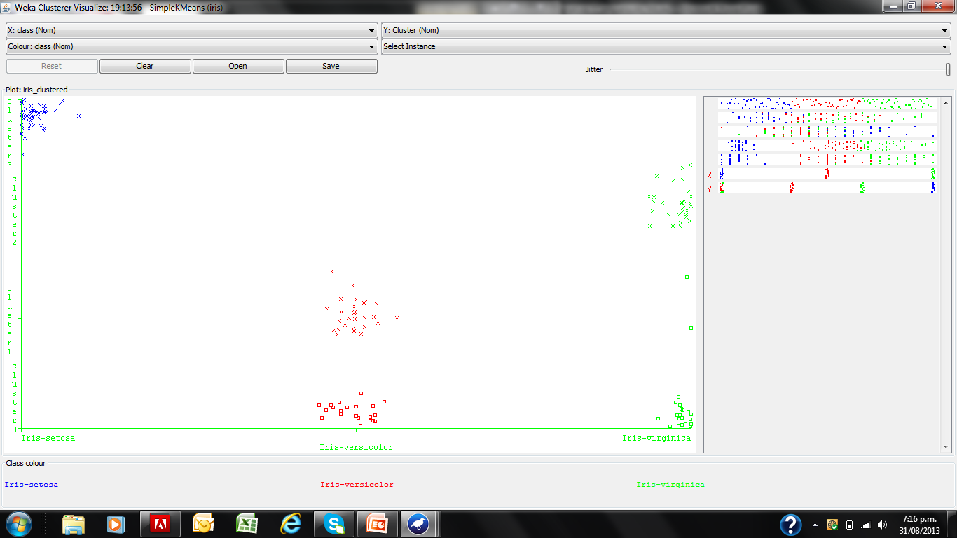
Cluster to Class Evaluation (k=4)

Slide 42
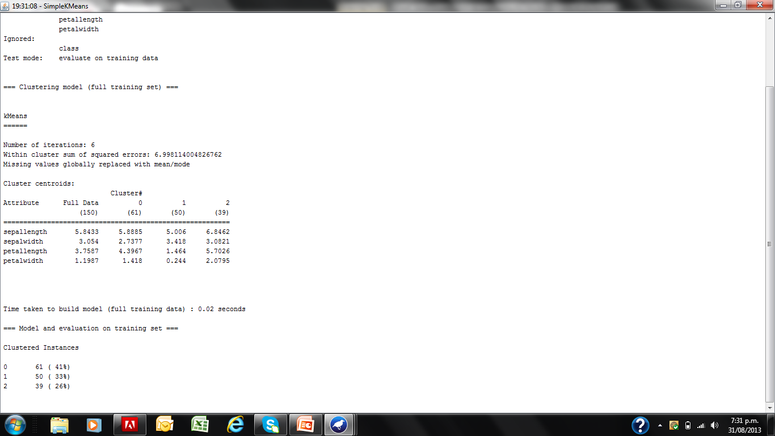
Evaluating K means through SSE (k=3)

Slide 43
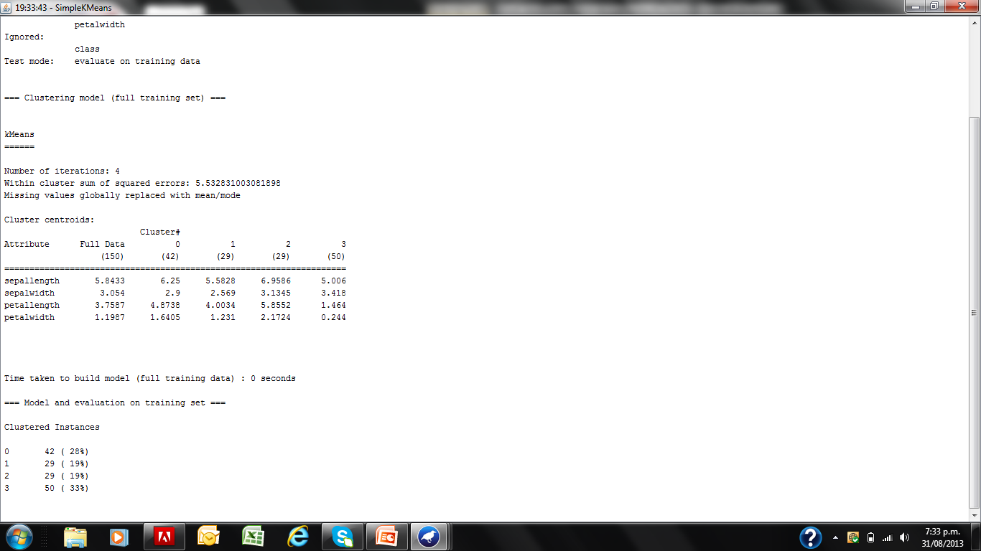
Evaluating K means through SSE (k=4)

Slide 44


Hierarchical Clustering
Produces a set of nested clusters organized as a hierarchical tree
Can be visualized as a dendrogram
  A tree like diagram that records the sequences of merges or splits

Slide 45
Strengths of Hierarchical Clustering
Do not have to assume any particular number of clusters
  Any desired number of clusters can be obtained by ‘cutting’ the dendogram at the proper level
They may correspond to meaningful taxonomies
  Example in biological sciences (e.g., animal kingdom, phylogeny reconstruction, …)

Slide 46
Hierarchical Clustering
Two main types of hierarchical clustering
  Agglomerative:
    Start with the points as individual clusters
    At each step, merge the closest pair of clusters until only one cluster (or k clusters) left
  Divisive:
    Start with one, all-inclusive cluster
    At each step, split a cluster until each cluster contains a point (or there are k clusters)
Traditional hierarchical algorithms use a similarity or distance matrix
  Merge or split one cluster at a time

Slide 47
Agglomerative Clustering Algorithm
More popular hierarchical clustering technique
Basic algorithm is straightforward
  Compute the proximity matrix
  Let each data point be a cluster
  Repeat
  Merge the two closest clusters
  Update the proximity matrix
  Until only a single cluster remains
Key operation is the computation of the proximity of two clusters
  Different approaches to defining the distance between clusters distinguish the different algorithms

Slide 48
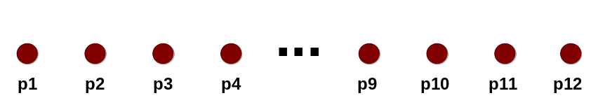
Starting Situation
Start with clusters of individual points and a proximity matrix
p1
p2
p3
p4
p5
. . .
p1
p2
p3
p4
p5
.
.
.
Proximity Matrix

Slide 49
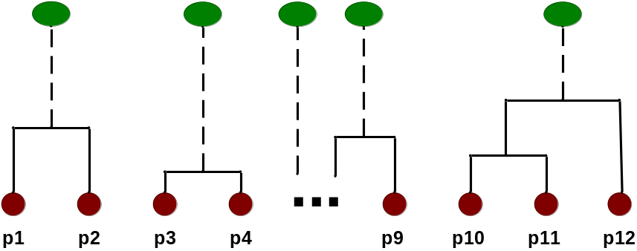
Intermediate Situation
After some merging steps, we have some clusters
C1
C2
C3
C4
C5
C1
C2
C3
C3
C4
C4
C5
Proximity Matrix
C1
C2
C5

Slide 50

Intermediate Situation
We want to merge the two closest clusters (C2 and C5) and update the proximity matrix.
C1
C2
C3
C4
C5
C1
C2
C3
C3
C4
C4
C5
Proximity Matrix
C1
C2
C5

Slide 51

After Merging
The question is “How do we update the proximity matrix?”
C2 U C5
C1
C3
C4
C1
?
C2 U C5
? ? ? ?
C3
C3
?
C4
C4
?
Proximity Matrix
C1
C2 U C5

Slide 52
How to Define Inter-Cluster Similarity
p1
p2
p3
p4
p5
. . .
p1
Similarity?
p2
p3
p4
p5
MIN
MAX
Group Average
Distance Between Centroids
.
.
.
Proximity Matrix

Slide 53
How to Define Inter-Cluster Similarity
p1
p2
p3
p4
p5
. . .
p1
p2
p3
p4
p5
MIN
MAX
Group Average
Distance Between Centroids
.
.
.
Proximity Matrix

Slide 54
How to Define Inter-Cluster Similarity
p1
p2
p3
p4
p5
. . .
p1
p2
p3
p4
p5
MIN
MAX
Group Average
Distance Between Centroids
.
.
.
Proximity Matrix

Slide 55
How to Define Inter-Cluster Similarity
p1
p2
p3
p4
p5
. . .
p1
p2
p3
p4
p5
MIN
MAX
Group Average
Distance Between Centroids
.
.
.
Proximity Matrix

Slide 56
How to Define Inter-Cluster Similarity
p1
p2
p3
p4
p5
. . .
p1
×
×
p2
p3
p4
p5
MIN
MAX
Group Average
Distance Between Centroids
.
.
.
Proximity Matrix

Slide 57
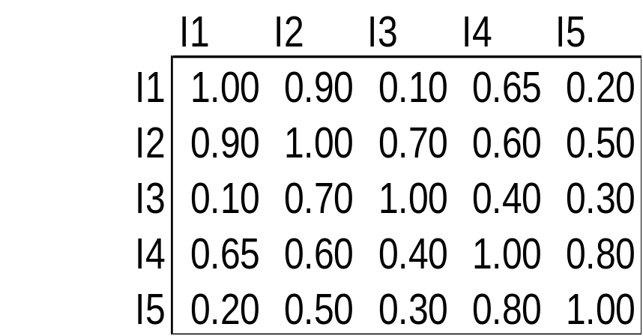
Cluster Similarity: MIN or Single Link
Similarity of two clusters is based on the two most similar (closest) points in the different clusters
  Determined by one pair of points, i.e., by one link in the proximity graph.
1
2
3
4
5

Slide 58

Hierarchical Clustering: MIN
5
1
3
5
2
1
2
3
6
4
4
Nested Clusters
Dendrogram

Slide 59
Other Clustering Algorithms
A popular algorithm based on Neural Networks is the Self Organizing Map (SOM) algorithm.
The SOM constructs a 2D topological map.
Data points in clusters map to neurons on the SOM.
SOM demo is at: http://www.cis.hut.fi/research/javasomdemo/demo2.html

